Slide 1
MVC
Model, View, controller

Slide 2
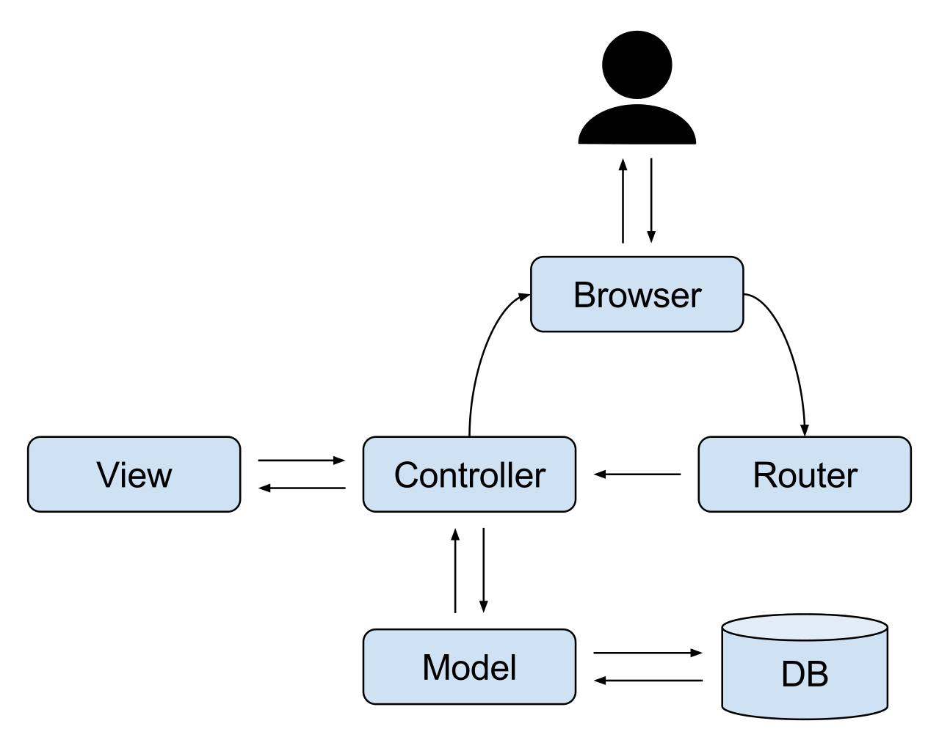
What is MVC?
What does the MVC acronym stand for?
Is it a another language or is it an approach?
What does it do?
Notes:
It’s an architectural approach that separates an application’s backend (server related code) into three main logical components: the model (database), the view (what the client sees), and the controller (server).

Slide 3
What does the controller do in MVC?
The Controller can be further divided into to two subcategories: the route and controller
Notes:
The router hears a user’s (post, put, delete, get) request and sends it to the appropriate controller (matches the route and get method) to handle said request.
The controller acts as the application’s middle man, it determines the appropriate response to the router request (may communicate with the view and/or model to complete the request). Once the request is completed (a html file is generated/database is altered) the controller responds to the result to the browser.

Slide 4
What does the view do in MVC
Notes:
It generates (upon a controller’s request) the content users will see and interact with using templating languages. Only communicates with the controller.

Slide 5
What does the model do in MVC?
Notes:
Interacts with your DB (adds, retrieves, changes and deletes items inside the DB) and it only speaks with the controller.
It may utilize use mongoose and a schema.

Slide 6

What’s mongoose and what does it do?
Notes:
It’s an object data modeling library for MongoDB.
It translates between the JavaScript code and mongoDB data objects and it can validate data passing into the database using schemas.

Slide 7
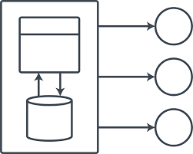
What’s schema?
Notes:
A document data structure that is enforced via the application layer, such as data types, required fields, and other properties

Slide 8

What are some of the benefits of using/following MVC?
Notes:
It allows for clear separation of concerns when dealing with our server-code
This makes our code reusable, prevents repetitions, makes making changes/adjustments easier and makes it easier to work in groups.

